Slide 1
Implementation of Hill Cipher using Python
DAYANANDA SAGAR COLLEGE
OF ENGINEERING
By
VISHVENDRA SINGH 1DS18EC156
SAMEER GAUTAM 1DS18EC144

Slide 2
INTRODUCTION
It is a multilevel cipher developed by the mathematician Lester Hill.
The encryption algorithm takes an successive Plain text letters and a key matrix and give Ciphertext letters.
Each letter is represented by a number modulo 26. Often the simple scheme A = 0, B = 1, …, Z = 25 is used, but this is not an essential feature of the cipher.
To encrypt a message, each block of n is multiplied by an invertible n × n Key matrix, against modulus 26. To decrypt the message, each block is multiplied by the inverse of the matrix used for encryption.

Slide 3
Encryption
Encrypting with the Hill cipher is built on the following operation:
E(K, P) = (K*P) mod 26
Where K is our key matrix,
and P is the plaintext in vector form.
Matrix multiplying these two terms produces the encrypted ciphertext.

Slide 4
Steps for Encryption
Let’s work with the plain text “PAYMOREMONEY”.
The encryption key is given as:
The first 3 letters of the Plain text are represented by the vector:
“PAY”, where P=15, A=0, Y=24.
PAY = [15, 0, 24].
17 5
18 21
2 2 19
KEY =

Slide 5
Plain Text:
PAY MOR EMO NEY
P A Y M O R E M O N E Y
15 0 24 12 14 17 4 12 14 13 4 24
[P]= [15, 0, 24] [12, 14, 17] [4, 12, 14] [13, 4, 24]

Slide 6
Then applying the formula for first 3 letters “PAY”, i.e.
E(K, P) = (K*P) mod 26
By solving the matrix, we get:
= [375 819 486] Mod 26
= [11 13 18]
Cipher Text = L N S
17 5
18 21
2 2 19
15
0
24
E =
mod 26

Slide 7
5. Applying the formula for next 3 letters “MOR”, i.e.
E(K, P) = (K*P) mod 26
By solving the matrix, we get:
= [527 861 375] Mod 26
= [7 3 1]
Cipher Text = H D L
17 5
18 21
2 2 19
12
14
17
E =
mod 26

Slide 8
6. Applying the same procedure for the next 6 letters, we get the Cipher text as:
For “EMO”, Cipher text = E W M.
For “NEY”, Cipher text = T R W.
The Final Cipher text after encryption is:
CIPHER TEXT = L N S H D L E W M T R W

Slide 9
Decryption
Decryption requires using the inverse of matrix K.
So we can find the inverse of K as :
If we apply K⁻¹ to Cipher Text, then we can recover the Plain Text.
So, we apply the formula to recover the Cipher Text:
K⁻¹
= | Adj K |
| K |
P = (K⁻¹
) C Mod 26

Slide 10
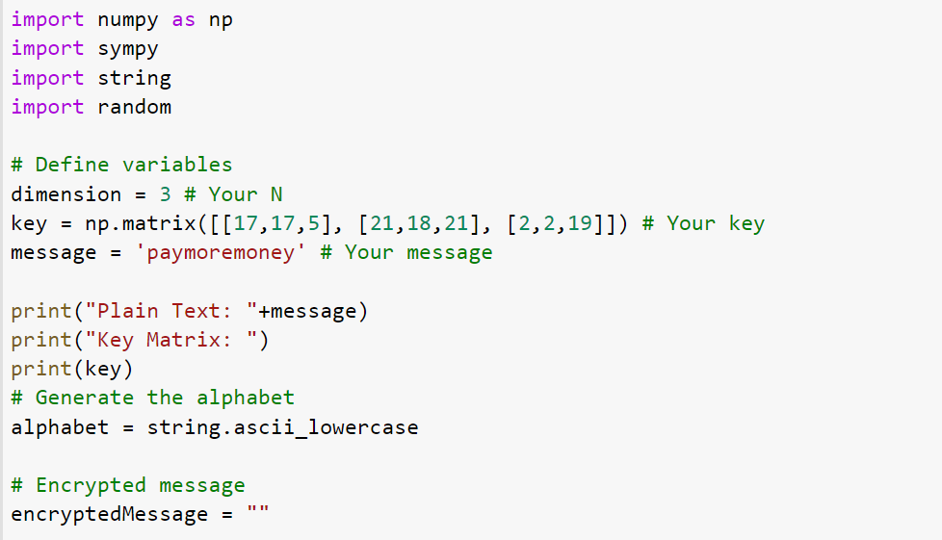
Implementation (PYTHON)

Slide 11
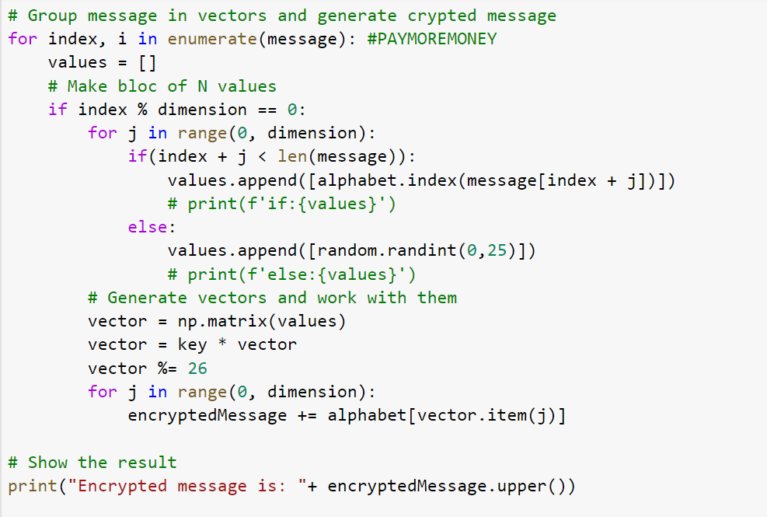

Slide 12
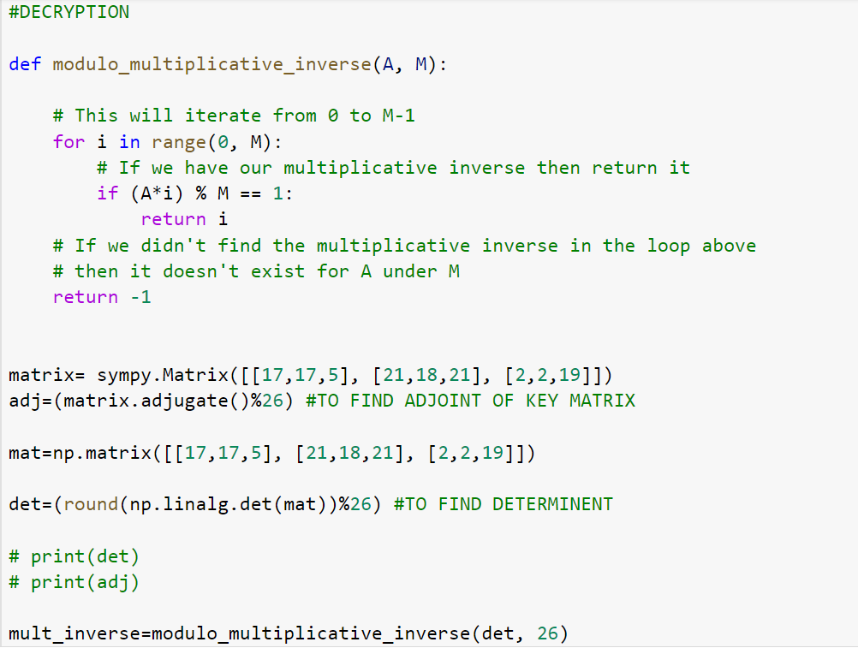

Slide 13
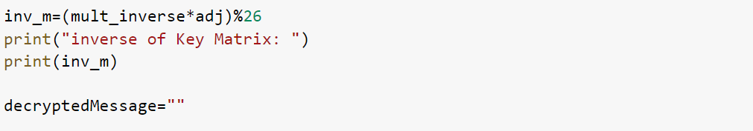
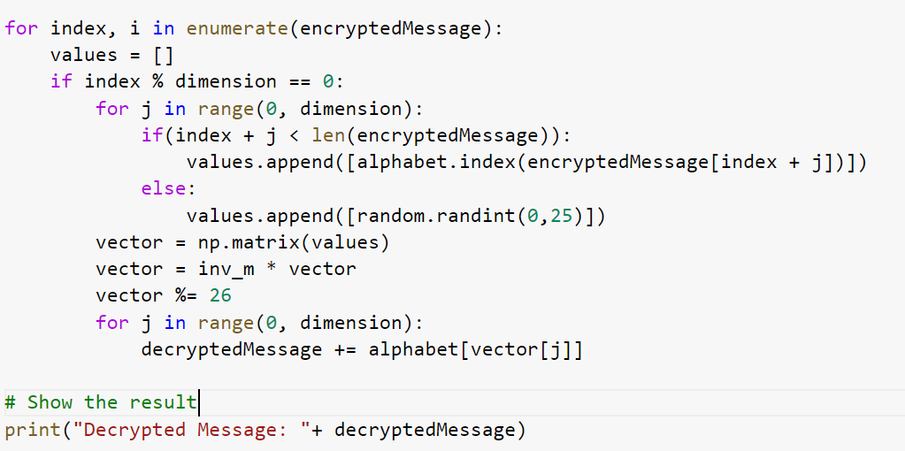

Slide 14
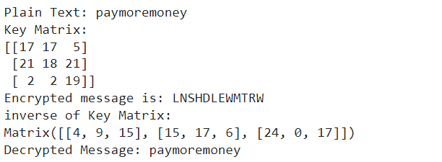
OUTPUT:

Slide 15
THANK YOU!

